Slide 1


Slide 2
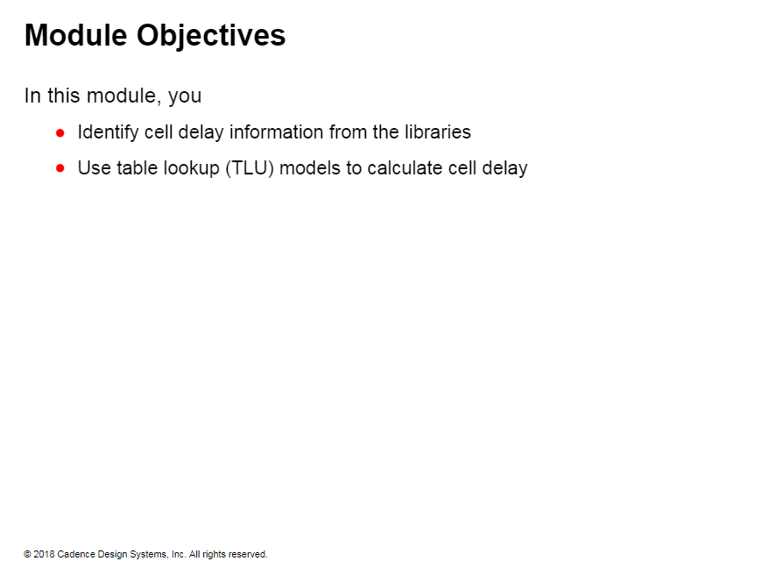

Slide 3
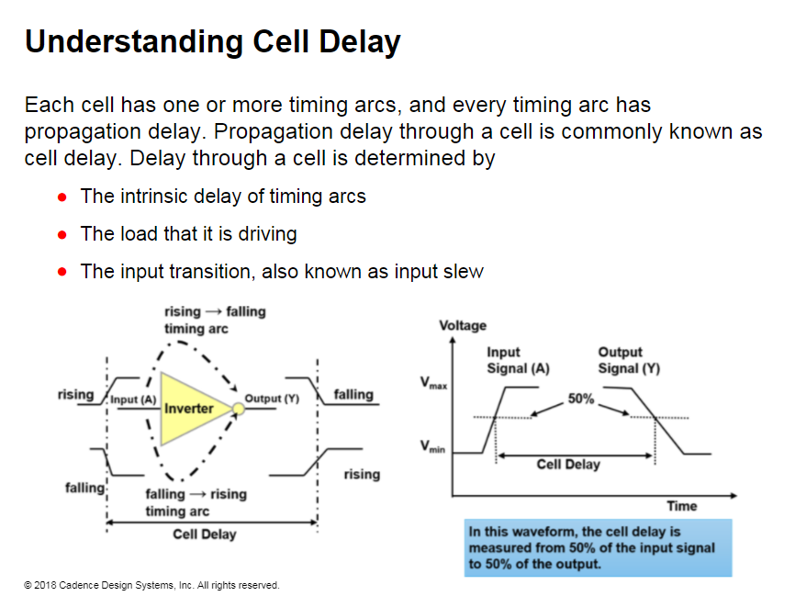

Slide 4
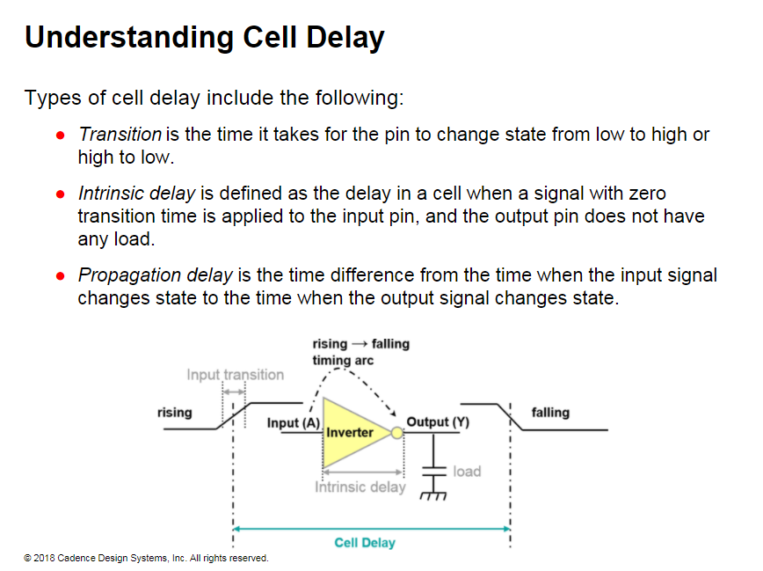
Notes:
Propagation Delay α 1/Voltage supply
Propagation Delay α Temperature

Slide 5
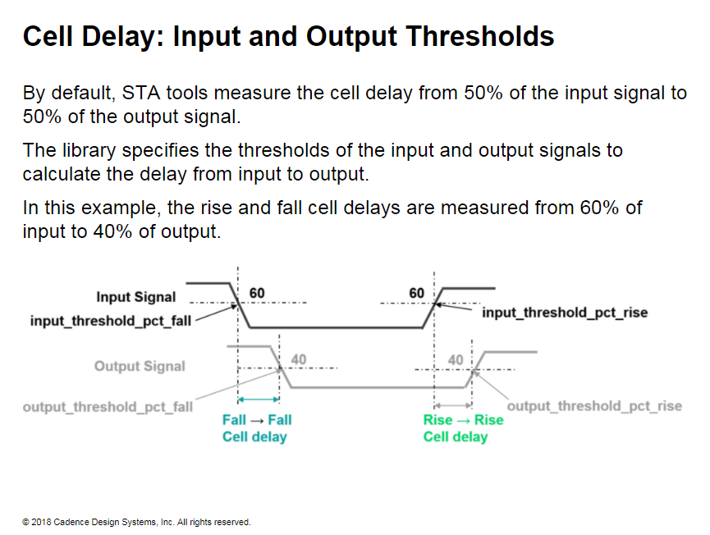
Notes:
STA tools use the signal threshold values to calculate the cell delays. The example here shows the signal threshold values from the .lib.
Example
#Signal thresholds in lib
input_threshold_pct_fall: 60.0;
input_threshold_pct_rise: 60.0;
output_threshold_pct_fall: 40.0;
output_threshold_pct_rise : 40.0;
STA tools calculate the rise delay from the input threshold_pet rise of 60 and output rise of 40.
Similarly, STA tools calculate the fall delay from the input threshold_pet_fall of 60 and output of 40.

Slide 6
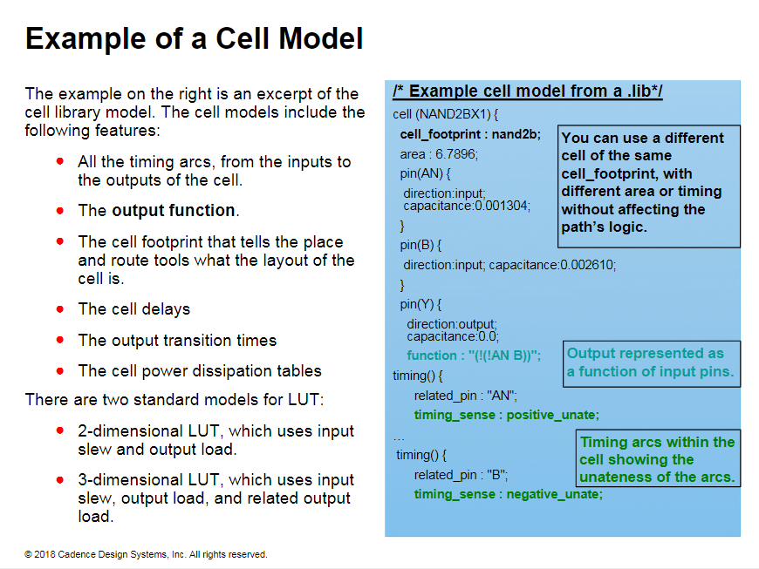
Notes:
Most standard cell libraries use a Lookup Table (LUT) within its cell models to provide timing delays as a function of input slew and output load.
LUT models have the accuracy of SPICE simulations. These models require only a few input variables and are very fast to use in calculating the delays of the paths.

Slide 7
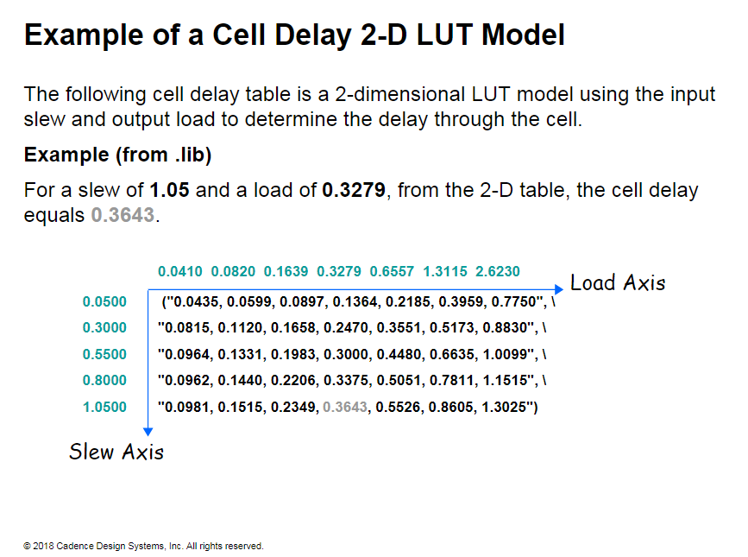

Slide 8
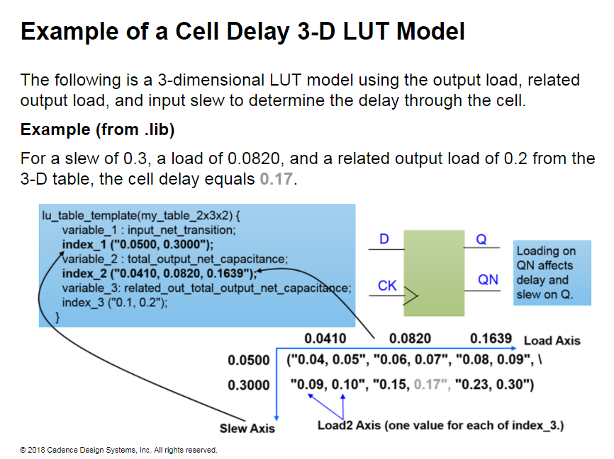
Notes:
Related output load is the capacitance load as seen b: the related output pins. For example. for a D flip-flop. the related output pin of the Q pin is Q. The related output load is the load as seen by Q and is used in calculating the delay for Q in 3-D LIT models.
How do 3-D LIT models work?
The illustration shows a three-dimensional lookup table.
The slew axis is the input net transition, and the load axis is the total output pin capacitance. The load2 axis is the related output pin capacitance.
After locating a pair of numbers in quotes from the slew and load axis, the STA tool chooses one number for the delay value based on the value of the load2 axis.
When the actual bad does not fall directly on or at one of the load-axis index points, the delay is determined by interpolation from the closest points.
The STA tool determines the equation for the line segment connecting the two nearest points in the table.
The STA tool solves for the delay at the load point of interest.
When the load point is outside the boundary of the table, the delay is extrapolated to the closest known points.
A sparse sampling point that is too far out of range can lead to inaccuracy.

Slide 9
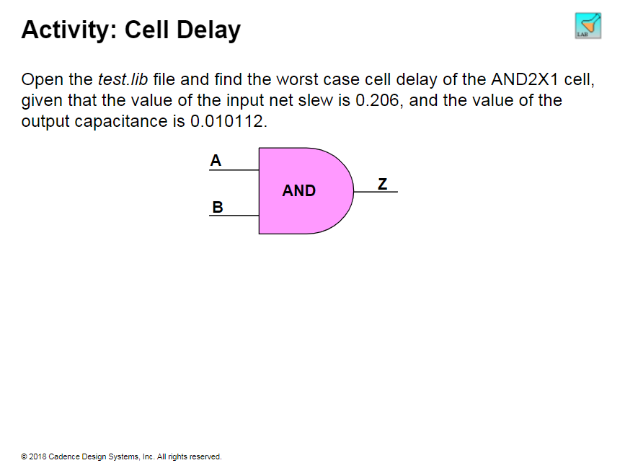
Notes:
Solution
In the library, the input slew and output load are the index_I and index_2 from delay template_7x7. Then, under the cell delay for AND2X1, you will find this LIT in the library: cell_rise(delay_template_7x7) { index_1("0.042, 0 066, 0.112, 0 206, 0392, 0.764, 1 5"); index_2(“0.00079, 0.002054, 0 00474, 0.010112. 0.020856, 0 042186, 0.08532“); values ("0.091522,0.102488, 0.123201, 0.161183, 0.234593, 0379090, 0.670558%1 "0.096236,0.107177, 0.127815, 0.165780, 0_239183, 0383702, 0.67518011 13105184, 0.116100, 0136686, 0.174547, 0 247873, 0392410, 0.68393811 13119600, 0.130721, 0151606, 0.189428, 0.262634, 0407105,0.698662",\ "0.133882,0.145795, 0167463, 0.205899, 0.279294, 0_423465, 0.714886",
Therefore, the value of the cell delay for A → Z rising = 0.189428
Similarly for the other timing arcs. you will find these values in their LUTs: The value of cell delay for A → Z falling = 0.216009 The value of cell delay for B → Z rising = 0.191553 The value of cell delay for B → Z falling = 0.233191
Therefore, the worst delay is through B → Z falling equals 0.233191.

Slide 10
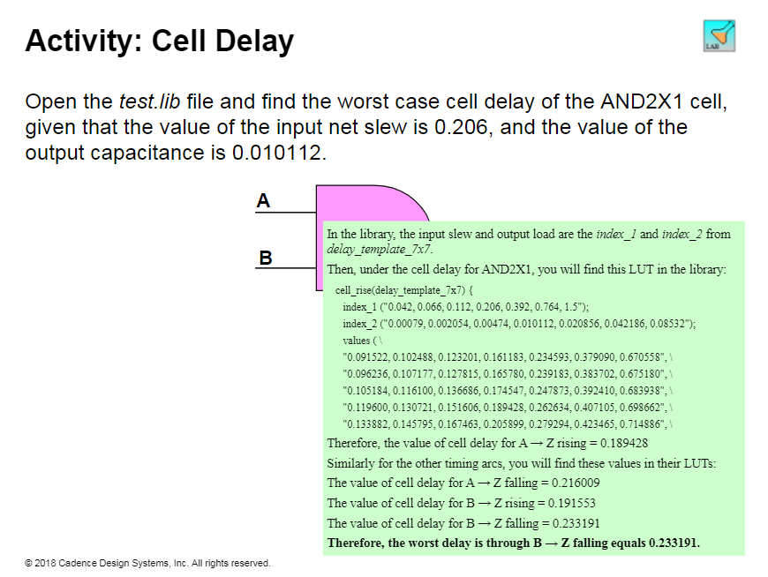

Slide 11
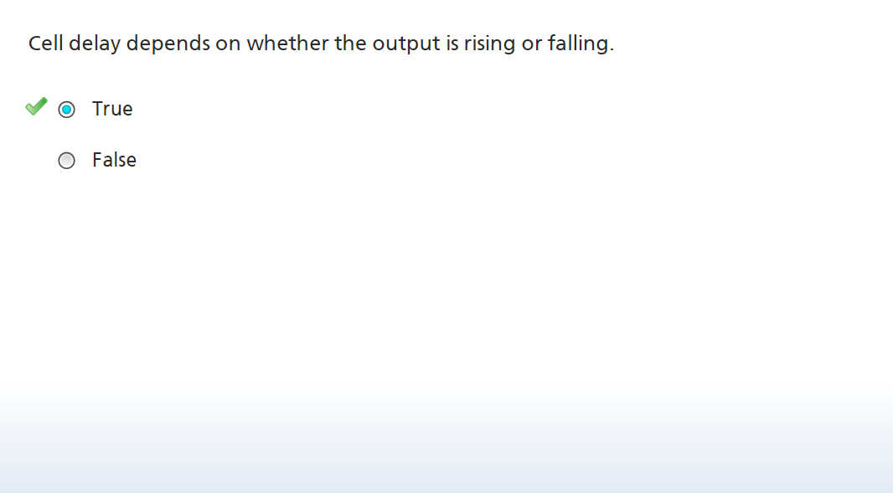

Slide 12
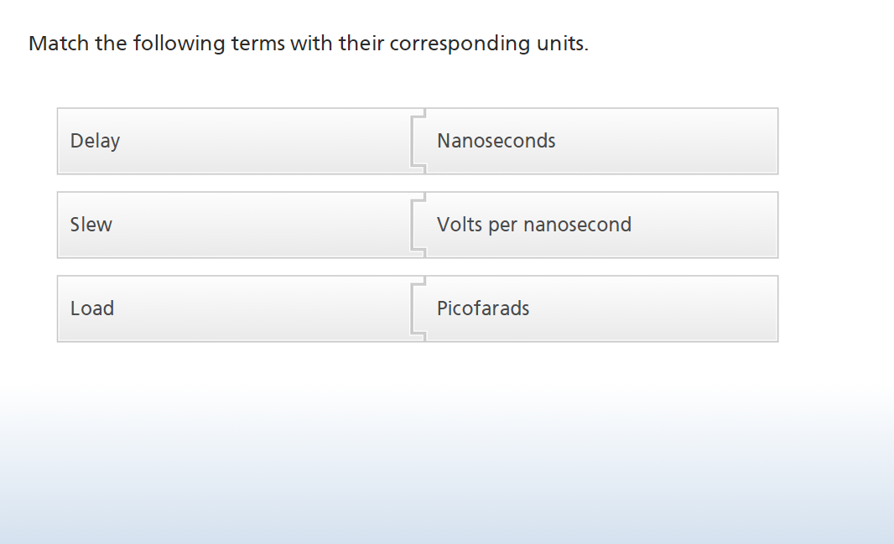

Slide 13
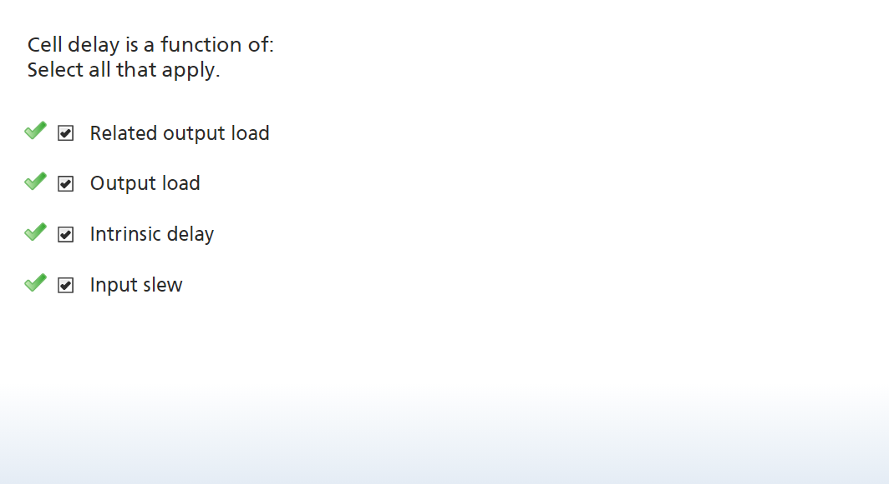

Slide 14
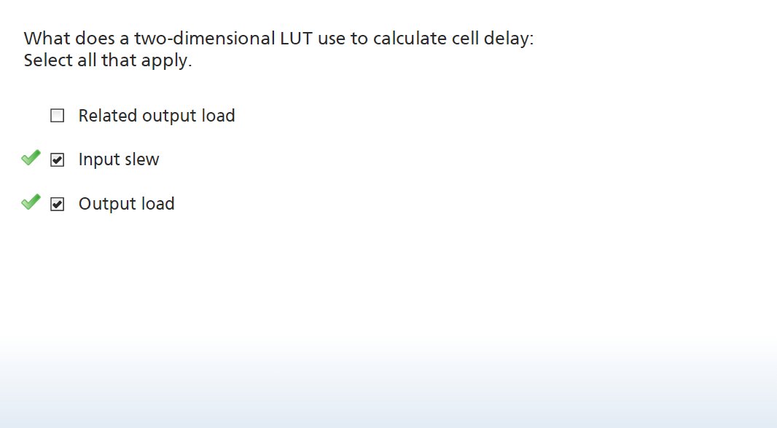

Slide 15
